Slide 1

POULTRY SCIENCE:
Nutrition
Unit 8

Slide 2
Poultry Science:
Nutrition
Unit 8: Segment 1
Nutritional Needs of Poultry

Slide 3
Why is nutrition important?
One of the most important aspects of poultry production:
Comprises 60-70% of production costs
Modern poultry industry production growth is a result of improvements in nutrition, genetics, and environment!
Commercial Poultry:
Birds need to grow rapidly & mature earlier

Slide 4
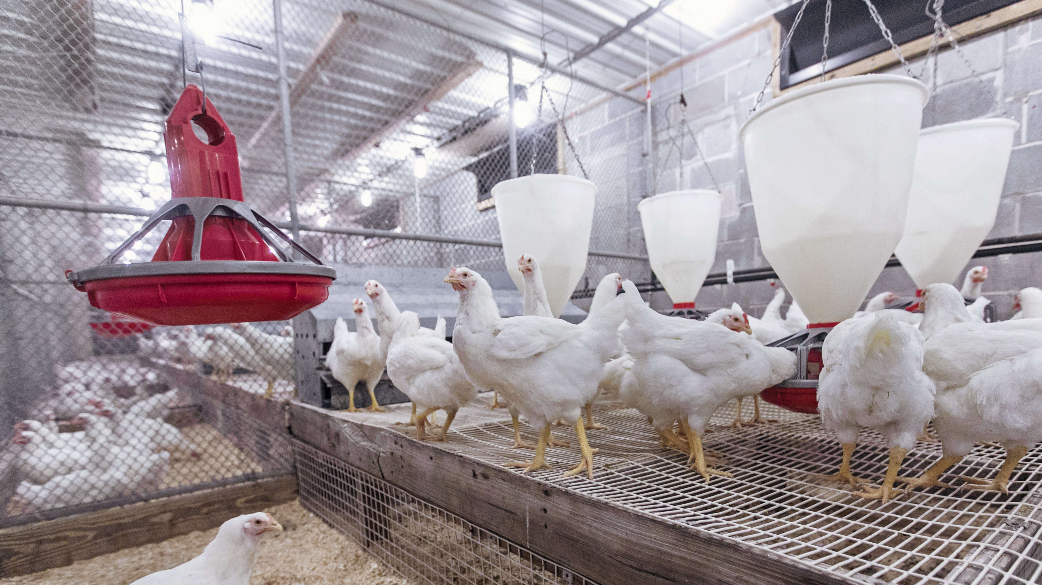
Why is nutrition important?
Proper nutrition and productivity are inextricably bound:
  Growth and productivity will be sacrificed without proper nutrition
  Optimizing growth
  Deficiencies or Toxicities

Slide 5
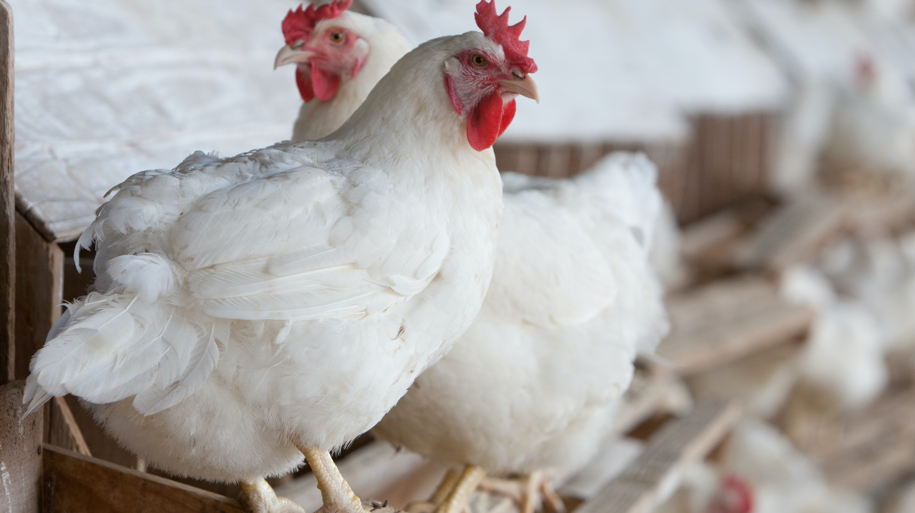
Major Nutrient Groups
Poultry must be provided with the following major nutrient groups:
  Proteins
  Energy
  Minerals
  Vitamins
  WATER!

Slide 6
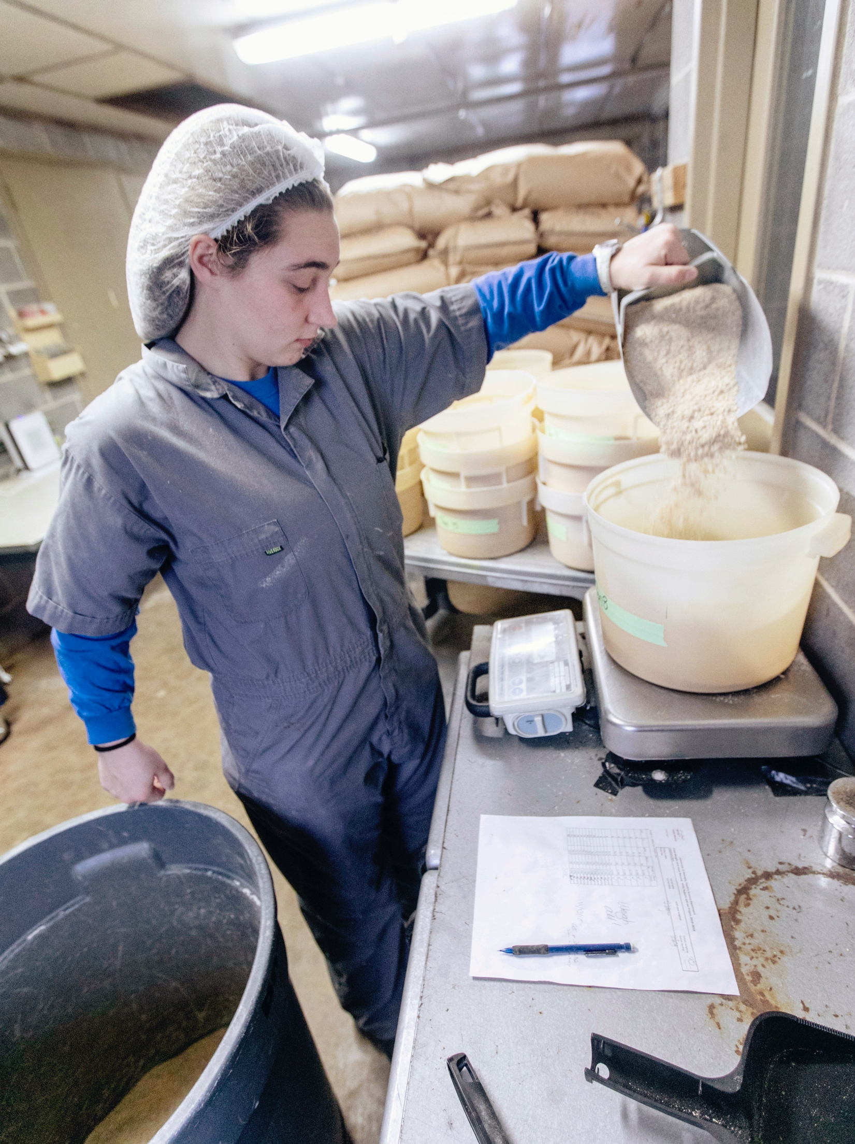
Nutritional Needs of Poultry
Feeding behaviors:
  Birds consume many small meals throughout the day
  Feed is almost always present in the gastrointestinal (G.I.) tract
  Feed must be present at all times for the birds in order to continue the above bullet points and meet their nutritional needs!
Newly hatched birds can survive on residual yolk from the egg!
  It is critical that the chicks get on feed as soon as possible
  Residual yolk is used to stimulate the digestive and absorptive function of the G.I. tract
  Yolk contains maternal antibodies, like colostrum in mammals!

Slide 7
Poultry Science:
Nutrition
Unit 8: Segment 2
Nutrient Groups & Dietary Sources

Slide 8
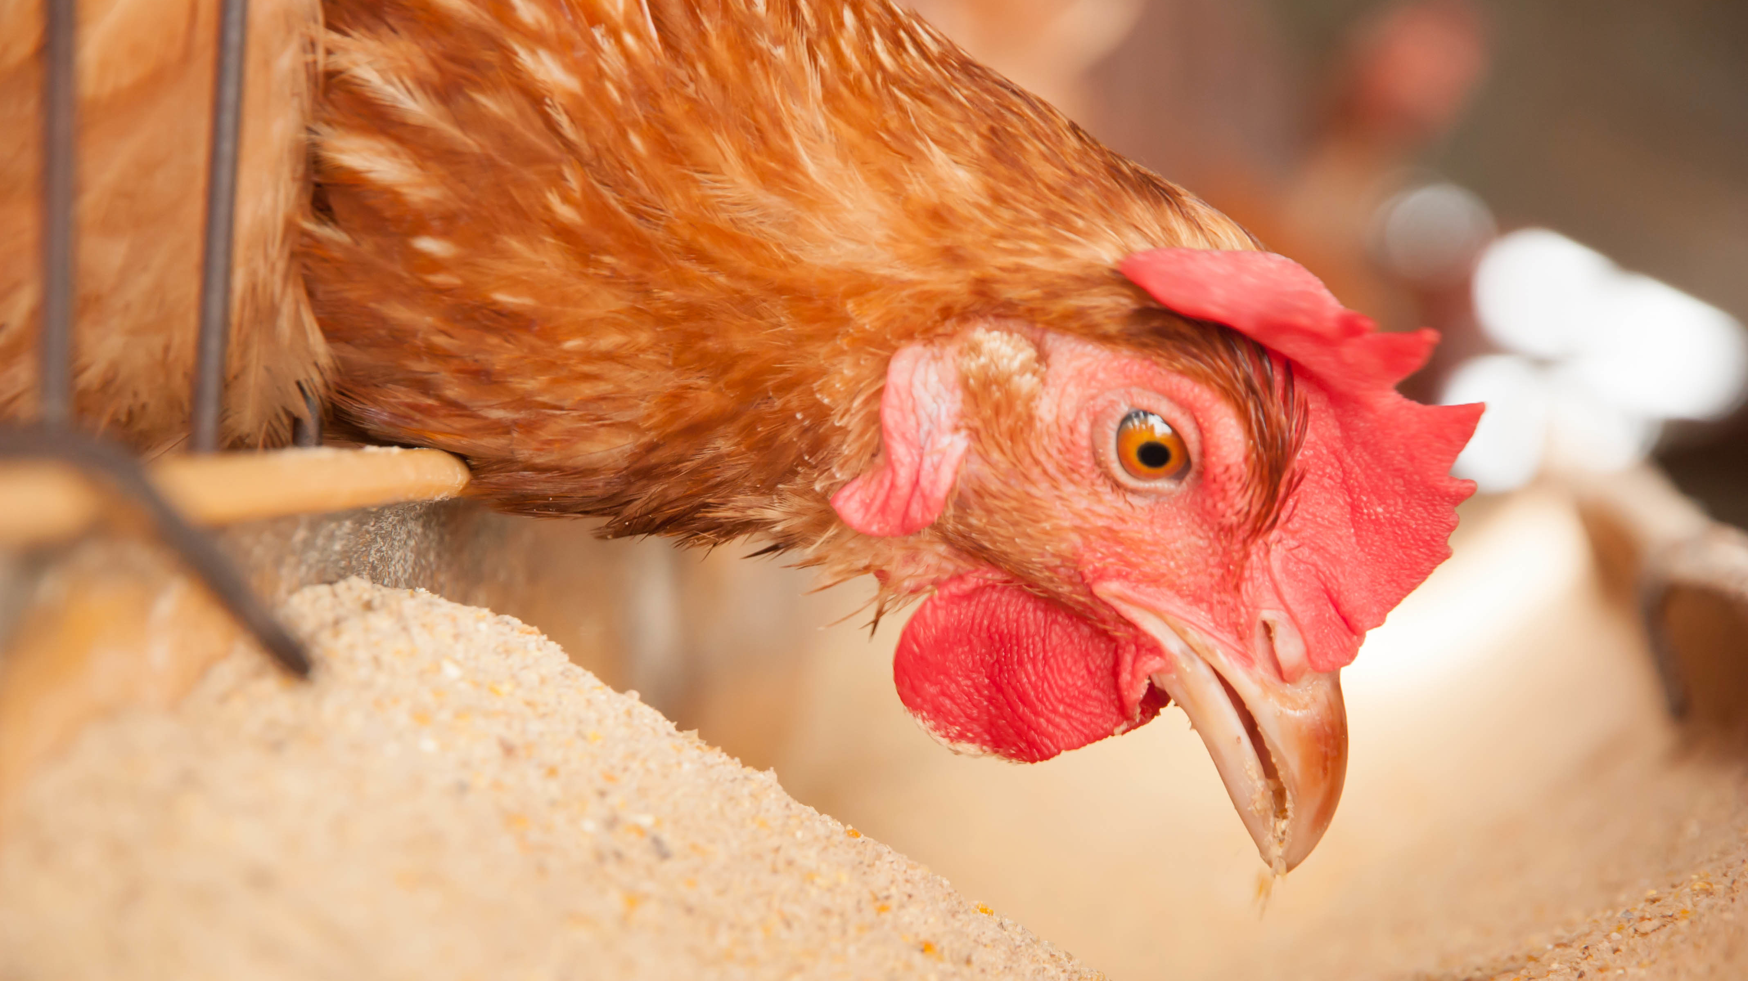
Nutrient Groups
Dietary Energy:
40-50% of feed costs
Derived from carbohydrate sources
Low Energy Diet = HIGH Consumption
High Energy Diet = LOW Consumption

Slide 9
Nutrient Groups
Dietary Energy Sources:
Cereal grains
  Corn
  Milo
Animal Fats
Vegetable Oils
Animal By-Product Meals
Soybeans
Simple Carbohydrates: Majority of energy from these sources
Dietary Lipid
Not an ideal source!

Slide 10
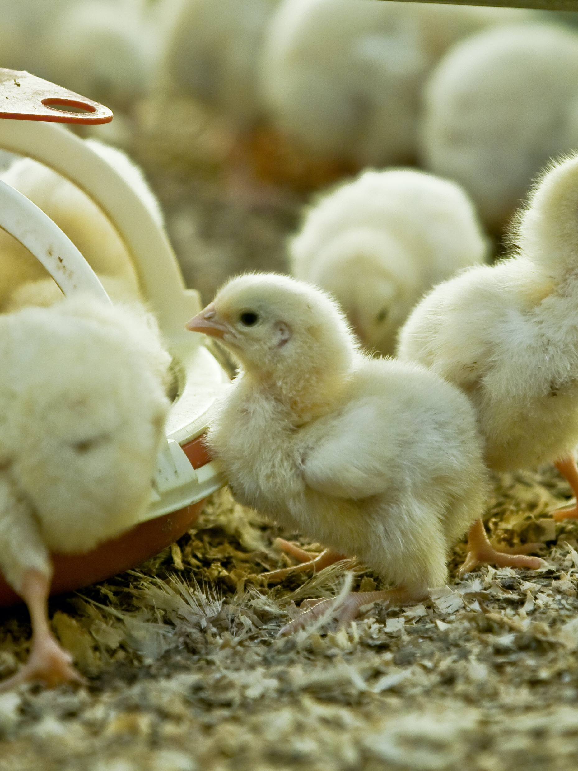
Nutrient Groups
Dietary Protein:
  Chains of Amino Acids (the building blocks of proteins)
    Essential Amino Acids: cannot be metabolized in the body – must be in feedstuffs
    Non-Essential Amino Acids: can be metabolized in the body
  Used in the body for formation of lean tissue, enzymes, hormones, and body metabolites
  Young animals use for building
  Old animals use for maintaining

Slide 11
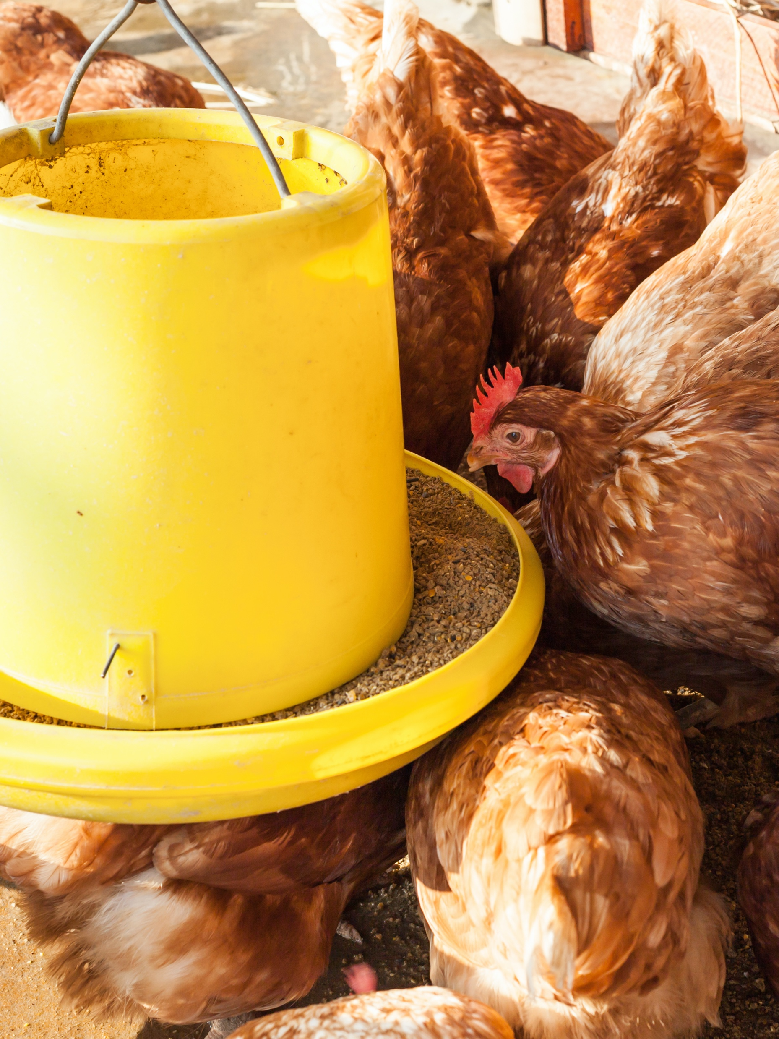
Nutrient Groups
Dietary Sources:
  Oilseed by-products from edible or functional oil production including:
    Soybean Oil, Peanut Oil, & Canola Oil
    40-60% protein in most cases
    Others can be used if available and cost effective
  Animal Protein By-Product Meals:
    Can include feather meal, blood meal, fish meal, meat and bone meal
    Product quality is extremely variable
    Comprise <5% of diet

Slide 12
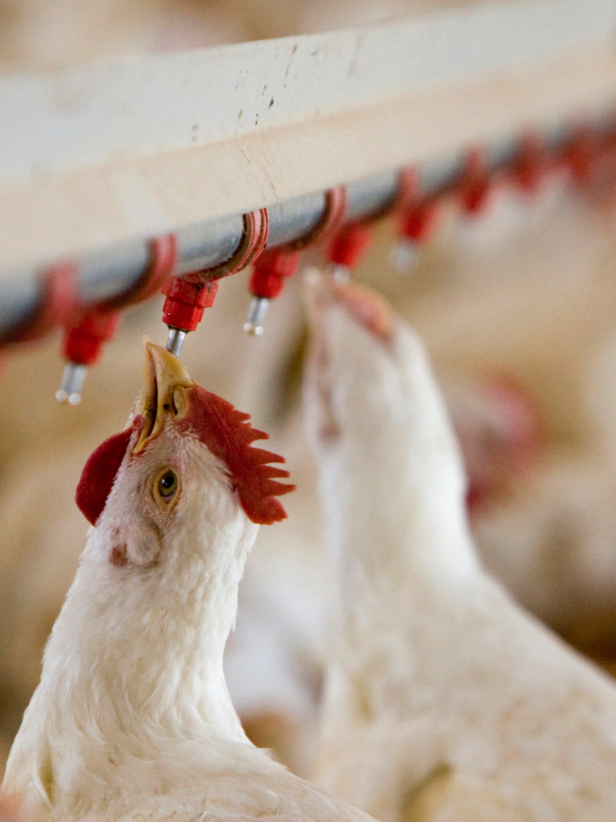
Nutrient Groups
Amino acid requirements are dependent on a variety of factors:
Age
Size of the Bird
Genetics of the Bird
Dietary Energy Level
  High energy diets require higher dietary amino acid density!
  Limiting Amino Acid = Growth will only reach the point of the limiting nutrient in the diet!

Slide 13
Nutrient Groups
Common poultry diets are limiting in the amino acid Lysine and the Sulfur amino acids (Methionine and Cysteine).
  Corn is relatively deficient in lysine
  Soybean meal is relatively deficient in methionine and cysteine
  Crystalline amino acid supplements are also added to the diet to meet nutrient requirements!

Slide 14
Amino Acid Digestibility
Digestibility – the amount of amino acid absorbed from the diet that does not end up being excreted.
How much of fed amino acid will actually be absorbed by the bird?
Nutrient Digestibility (%) = Nutrient Intake – Nutrient in Feces x 100
Nutrient Intake

Slide 15
Try it out:
Amino Acid Digestibility
Ingredient A contains 1.5% lysine with a digestibility of 90%.
Ingredient B contains 2.0% lysine with a digestibility of 50%.
Which ingredient is contributing more to the dietary lysine?

Slide 16
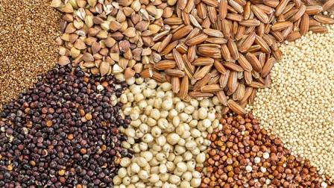
Dietary Vitamins
Dietary Vitamins – organic compounds needed by the body in very small amounts.
  Requirements in poultry are relatively high compared to other animals, and few are synthesized in the G.I. tract.
  Fat Soluble vs. Water Soluble
  Fat Soluble Vitamins:
    A: vision, reproduction, bone development
    D: Calcium absorption
    E: Antioxidant, protects cells form oxidative damage
    K: Blood clotting
  Water Soluble Vitamins:
    Ascorbic acid, niacin, biotin, choline, etc.
  Dietary Sources: Pre-Made Vitamin Mix

Slide 17
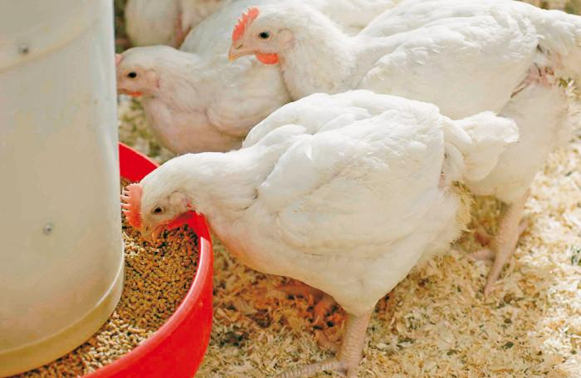
Dietary Minerals
Dietary Minerals – inorganic constituents of bones and teeth, etc. and is important for enzyme function, immunity and oxygen transport.
Macro Minerals:
  Required in relatively large amounts
  Ca, P, Na
Micro Minerals:
  Required in relatively small amounts
  Zn, Fe, Mn, Cu, Se, I
Dietary Sources: Salt, oyster shells, lime, bone meal

Slide 18
Non-Nutritive Feed Additives
Coccidiostats – commonly used to protect birds from disease-causing organisms that cause coccidiosis, a disease that can impair growth and cause increased mortality.
Antibiotics – Some antibiotics have growth-promoting abilities due to their ability to improve gut health and nutrient absorption. These particular types of antibiotics in poultry are not relevant in human medicine (i.e. NEVER USED). However, strict guidelines are in place to regulate the use of these and overall the use of antibiotics is declining.
Hormones – Use of any type of growth hormones, etc. have always been against federal law, therefore ALL COMMERCIAL POULTRY IS PRODUCED HORMONE-FREE.

Slide 19

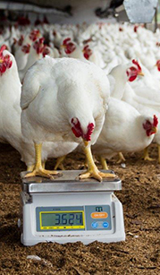
Diet Formulation
Commercial nutritionists often use least-cost formulations for diets using computer programs that require the following information:
  Needed/required nutrients
  List of all available ingredients
  Nutrient composition of available ingredients
  Ingredient costs
  Computer will then figure the least expensive formulation while still meeting all dietary requirements.
  Feed Forms: Mash, crumble, or pelleted

Slide 20
Poultry Science:
Nutrition
Unit 8: Segment 3
Nutrient Disorders

Slide 21
Nutritional Issues
Diet
Human Error (Improper Formulation)
Ingredient Variation
Ingredient Antagonism
Malabsorption
Gastrointestinal Disease
Physiology
Feeding Management
Overproduction/Under Consumption
Feed Separation
Feed Management
Oxidation of Ingredients
Degradation

Slide 22
Nutritional Issues
Most companies run their own analytical chemical lab tests to test the feed ingredients.
Changing genetics of the birds requires constant nutritional changes.

Slide 23
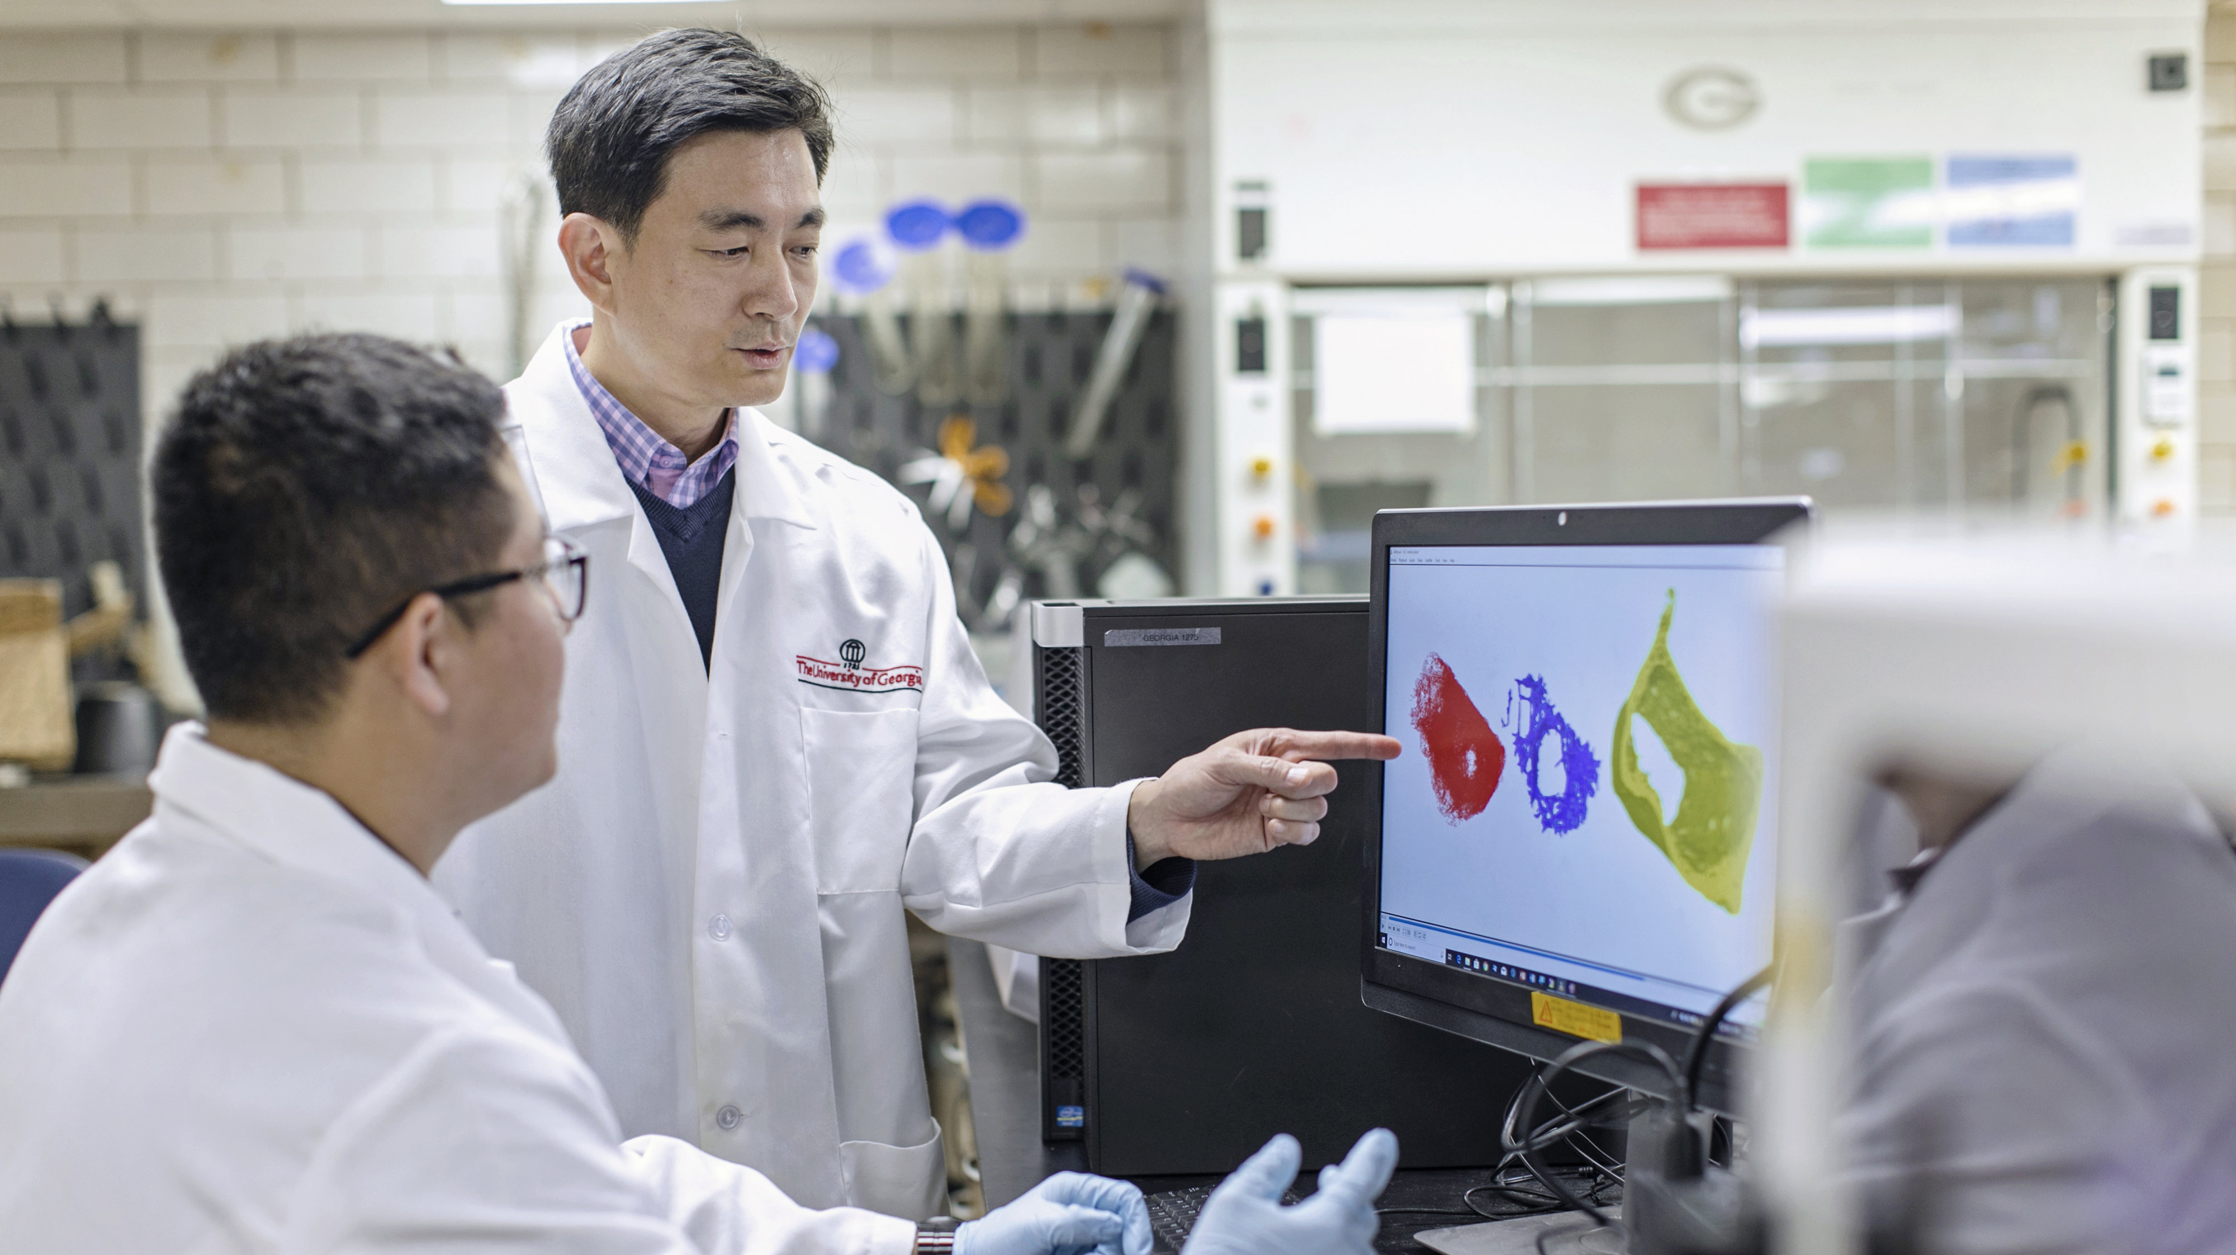
Now Let’s Take a Look at a Few Common Nutrient Disorders!

Slide 24
Tibial Dyschondroplasia (TD)
Incomplete ossification at the active growth plate
Occurs in fast-growing meat birds
Most common in broilers 21-35 days of age
Exact cause is unknown, but it seems that TD occurs more frequently when the diet contains an excess of sodium relative to potassium when chloride levels re very high.
Prevention:
  Adjustment of dietary levels of Ca:P
  Consideration of dietary electrolyte balance
  Reduced growth rate
  Mycotoxin control

Slide 25
Vitamin E Deficiency
(Crazy Chick Syndrome)
A neurological disease induced by a Vitamin E deficiency that is characterized by increased excitability, ataxia, wing-flapping, and paresis progressing to paralysis in young (usually 2-3 week old) birds.
Chicks with a Vitamin E deficiency may also have a selenium deficiency.
Will first notice pale, staggering birds with deformed wing feathers.
  “Stargazers”
Poults will be unthrifty with above-normal mortality.

Slide 26
Sudden Death Syndrome (SDS/Flip Over)
Seen mostly in fast-growing broilers – usually males.
Normal incidence is from 1.5-2.5% of the flock and peaks between 21-28 days of age.
Afflicted birds appear healthy, are well-fleshed, and have feed in their digestive tracts.
Death occurs within 1-2 minutes and the birds are usually found on their backs.
Since the condition is precipitated by fast growth rate, it can be prevented through nutrient restriction.

Slide 27
Fatty Liver
Hemorrhagic Syndrome
Most often seen in young adult cage layers and occasionally in older caged hens and floor layers.
Causes aren’t completely known, but some theories suggest estrogenic hormones, simple corn soy diets, over-consumption of feed, pullets being left on low calcium for too long after production starts, etc.
Hens will have oily feathers, increased mortality, and low egg production peak drops too quickly (or egg production may not be affected at all).
Prevention through use of diets with ingredients that contribute organic selenium + unidentified nutrient (wheat, alfalfa meal, fish meal, etc.)
Environmental temperatures and geographic location influences occurrence
  Happens world-wide!

Slide 28
Poultry Science
Curriculum References
Jessica Fife, UGA Dept. of Poultry Science Outreach Coordinator, UGA Dept. of Agricultural Leadership, Education, & Communication MAEE Candidate
Barry Croom, UGA Dept. of Agricultural Leadership, Education, & Communication Professor
Ashley Yopp, UGA Dept. of Agricultural Leadership, Education, & Communication Assistant Professor
Georgia Agriculture Education
Andrew Benson, UGA Dept. of Poultry Science Assistant Professor
Brian Jordan, UGA Dept. of Poultry Science Assistant Professor, UGA College of Veterinary Medicine Assistant Professor
University of Arkansas Bumpers College of Poultry Science – Poultry Science Dual Curriculum Course
Julia Gaskin, UGA Dept. of Crop and Soil Sciences Sr. Public Service Associate
Glendon Harris, UGA Dept. of Crop and Soil Sciences Professor & Extension Agronomist
Brian Kiepper, UGA Dept. of Poultry Science Associate Professor
Claudia Dunkley, UGA Dept. of Poultry Science Public Service Associate
Casey Ritz, UGA Dept. of Poultry Science Professor
USPOULTRY & USPOULTRY Poultry Science Curriculum
Tom Tabler, Mississippi State University Department of Poultry Science Extension Professor
Jacquie Jacob, University of Kentucky
Jeanna Wilson, UGA Dept. of Poultry Science Professor
Kelly Sweeney, UGA Dept. of Poultry Science Ph.D Candidate
Merck Veterinary Manual
University of Maryland Extension
Poultry Hub
Brian Fairchild, University of Georgia Department of Poultry Science Professor
Centers for Disease Control
National FFA Organization

